Slide 2
Chapter 5 Circular Motion; Gravitation

Slide 3
Contents of Chapter 5
Kinematics of Uniform Circular Motion
Dynamics of Uniform Circular Motion
Highway Curves, Banked and Unbanked
Nonuniform Circular Motion
Newton’s Law of Universal Gravitation

Slide 4
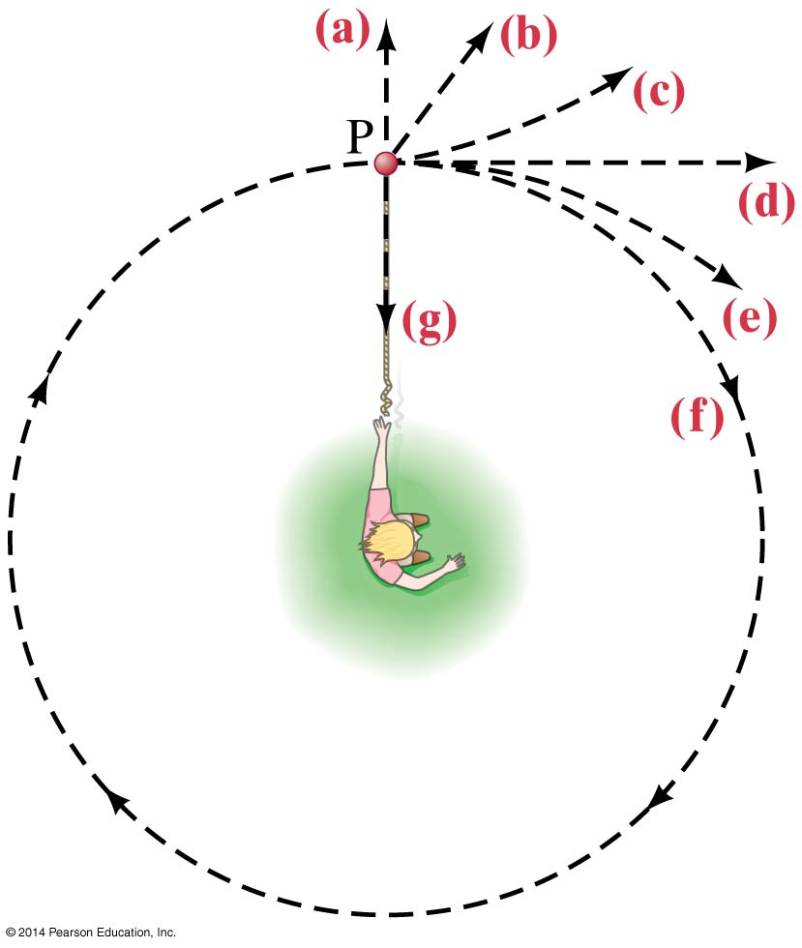
Contents of Chapter 5
Gravity Near the Earth’s Surface
Satellites and “Weightlessness”
Planets, Kepler’s Laws, the Moon, and Newton’s Synthesis
Types of Forces in Nature

Slide 5
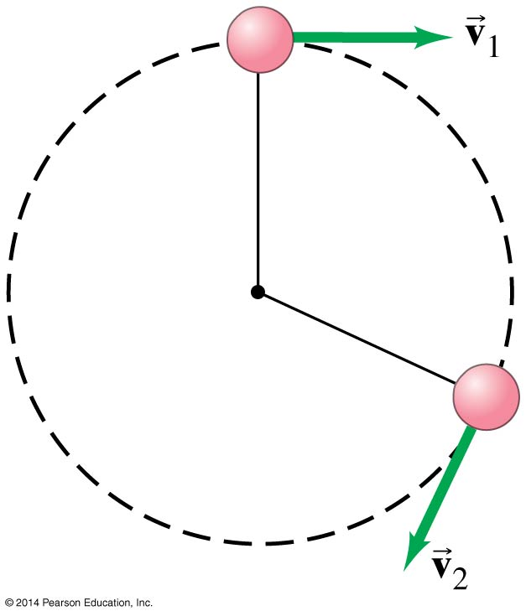
5-1 Kinematics of Uniform Circular Motion
Uniform circular motion: motion in a circle of constant radius at constant speed
Instantaneous velocity is always tangent to circle.

Slide 6
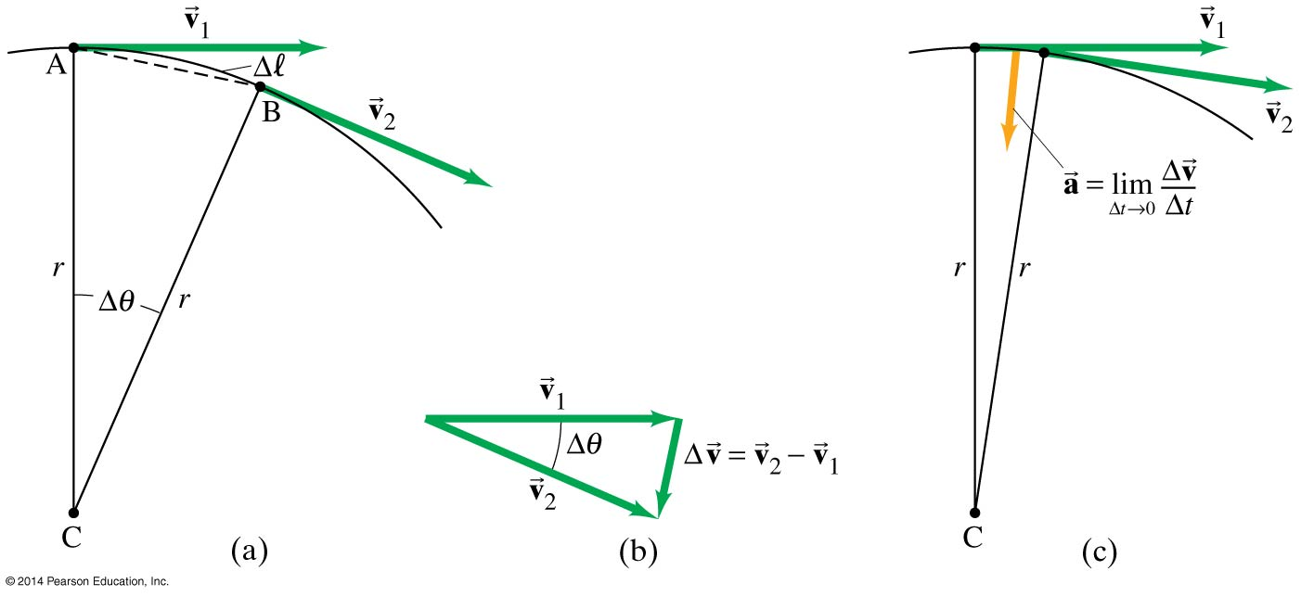
5-1 Kinematics of Uniform Circular Motion
Define velocity and acceleration?
Looking at the change in velocity as the limit for the time interval becomes infinitesimally small, we see that
(5-1)

Slide 7
5-1 Moon’s Centripetal Accel.
The Moon’s nearly circular orbit around the Earth has a radius of about 3.84 x 10⁵ km and a period T of 27.3 days. Find the acceleration of the Moon toward the Earth. Express in terms of m/s².

Slide 8
5-1 Moon’s Centripetal Accel.
G: r = 3.84 x 10⁵ km, T = 27.3 days
F: a = ??
E: c = 2πr, v = d/t = 2πr/T,
S&S: a_{R} = $\frac{4 π^{2}\left(3.84 x {10}^{8} \right) }{{(2.36 x10}^{6})^{2}}$
Ans: a_{R} = 2.72 x 10⁻³ m/s² or 0.0003g

Slide 9
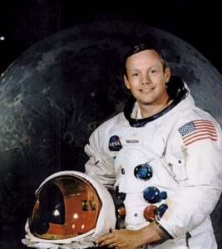
5-1 Moon’s Centripetal Accel.
What is the net acceleration of the moon?
What is the net acceleration of Neil Armstrong standing on the moon?

Slide 10
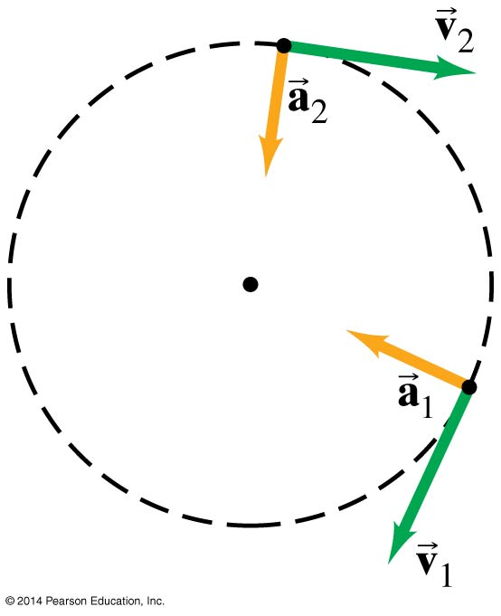
5-1 Kinematics of Uniform Circular Motion
This acceleration is called the centripetal, or radial acceleration, and it points towards the center of the circle.

Slide 11
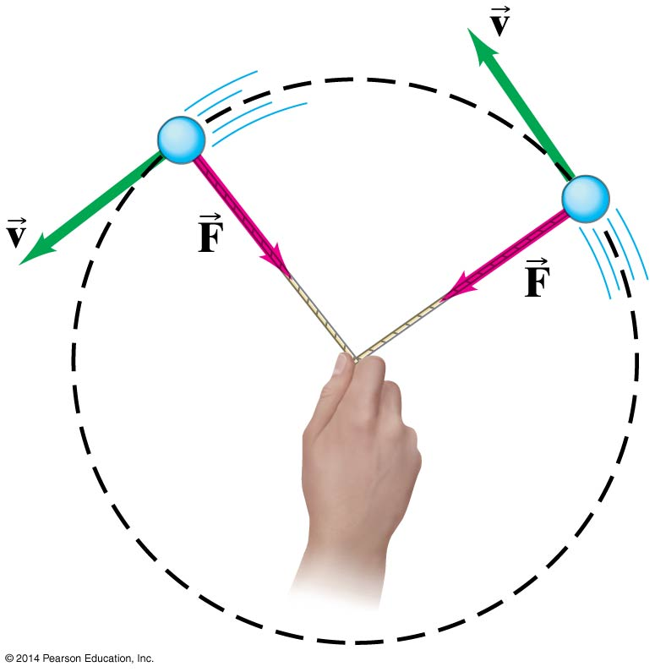
5-2 Dynamics of Uniform Circular Motion
For an object to be in uniform circular motion, there must be a net force acting on it.
We already know the acceleration, so can immediately write the force:
(5-3)

Slide 12
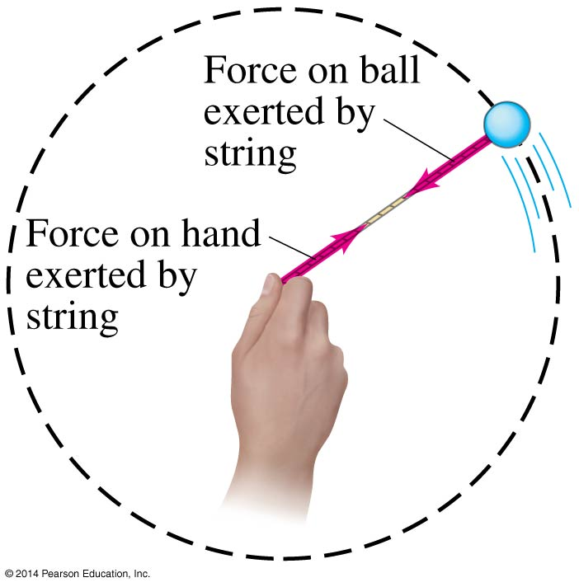
5-2 Dynamics of Uniform Circular Motion
We can see that the force must be inward by thinking about a ball on a string:

Slide 13
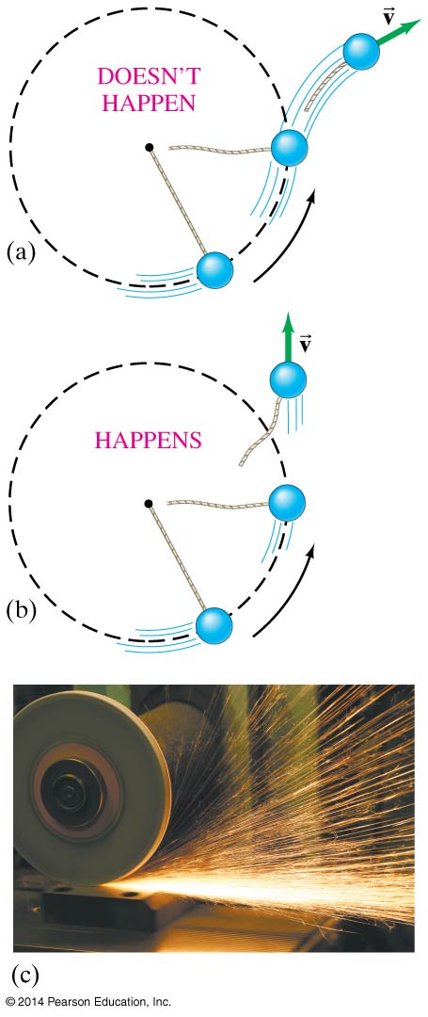
5-2 Dynamics of Uniform Circular Motion
There is no centrifugal force pointing outward; what happens is that the natural tendency of the object to move in a straight line must be overcome.
If the centripetal force vanishes, the object flies off tangent to the circle.

Slide 14
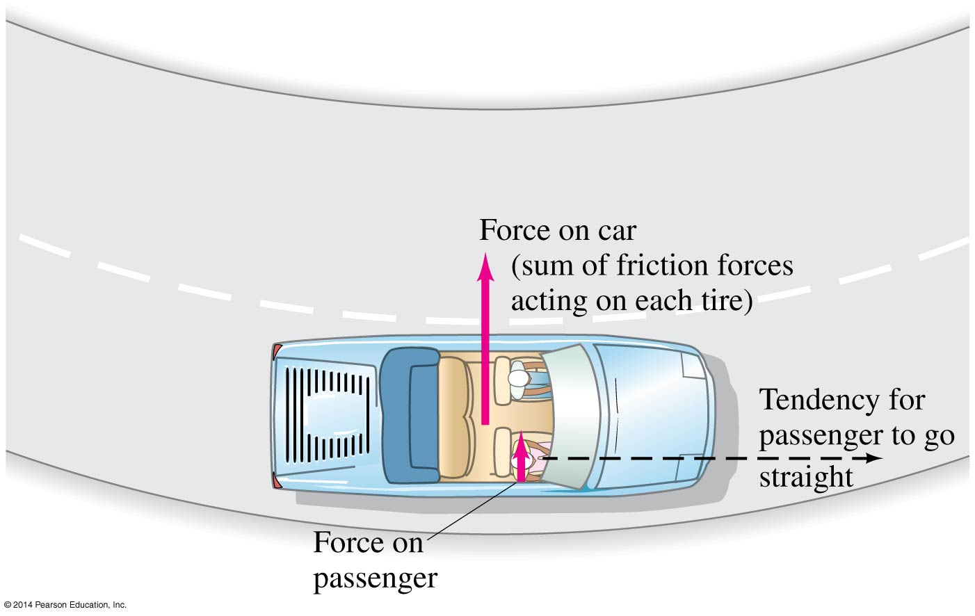
5-3 Highway Curves, Banked and Unbanked
When a car goes around a curve, there must be a net force towards the center of the circle of which the curve is an arc. If the road is flat, that force is supplied by friction.

Slide 15
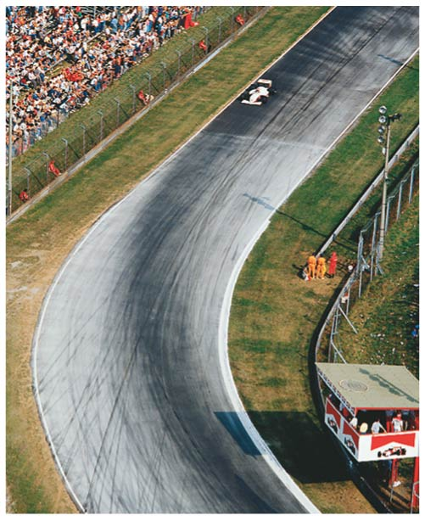
5-3 Highway Curves, Banked and Unbanked
If the frictional force is insufficient, the car will tend to move more nearly in a straight line, as the skid marks show.

Slide 16
5-3 Highway Curves, Banked and Unbanked
As long as the tires do not slip, the friction is static. If the tires do start to slip, the friction is kinetic, which is bad in two ways:
The kinetic frictional force is smaller than the static.
The static frictional force can point towards the center of the circle, but the kinetic frictional force opposes the direction of motion, making it very difficult to regain control of the car and continue around the curve.

Slide 17
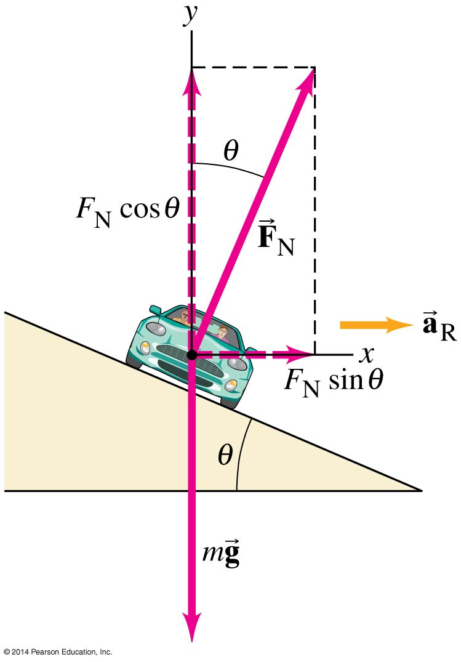
5-3 Highway Curves, Banked and Unbanked
Banking the curve can help keep cars from skidding. In fact, for every banked curve, there is one speed where the entire centripetal force is supplied by the horizontal component of the normal force, and no friction is required. This occurs when:

Slide 18
Banked Highway Curves
What is the angle θ for a road which has a curve radius of 50m with a speed of 50 km/hr and needs no friction to negotiate the corner.

Slide 19
Banked Highway Curve
$\frac{\sin{θ}}{\cos{θ}}$ = ???
$\frac{\sin{θ}}{\cos{θ}}$ = $\frac{\frac{O}{H}}{\frac{A}{H}}$ = $\frac{O}{A}$ = tan θ

Slide 20
Banked Highway Curve
G: r = 50 m, v = 50 km/h = 14 m/s, No friction
F: θ = ??
Equ: F_{N} sin θ = m $\frac{v^{2}}{r}$ and
F_{N} cos θ – mg = 0 F_{N} = $\frac{mg}{\text{cos} \text{θ}}$
Combine equations $\frac{mg}{\cos{θ}}$ sin θ = m $\frac{v^{2}}{r}$
Which becomes tan θ = $\frac{v^{2}}{rg}$

Slide 21
Banked Highway Curve
Sub. and Solve: tan θ = $\frac{{(14m/s)}^{2}}{(50 m)(9.8)}$ = 0.40
θ = tan ⁻¹ (0.4) = 22º (page 117)
Ans: θ = 22º
Please know how to do this for a quiz next week!!

Slide 22
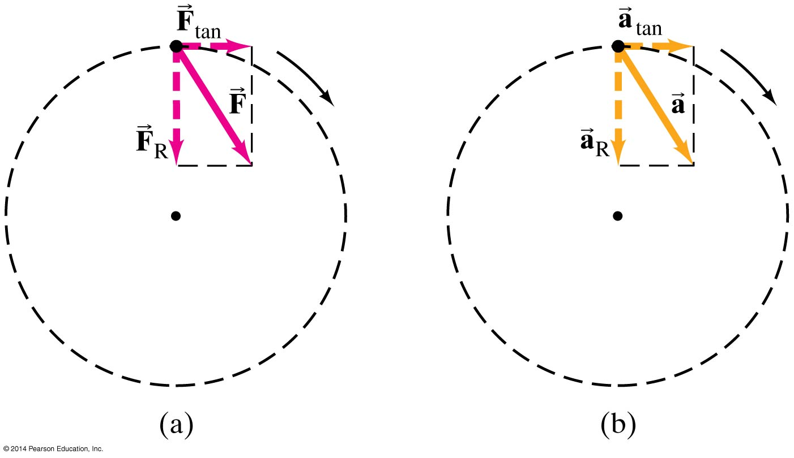
5-4 Nonuniform Circular Motion
If an object is moving in a circular path but at varying speeds, it must have a tangential component to its acceleration as well as the radial one.

Slide 23
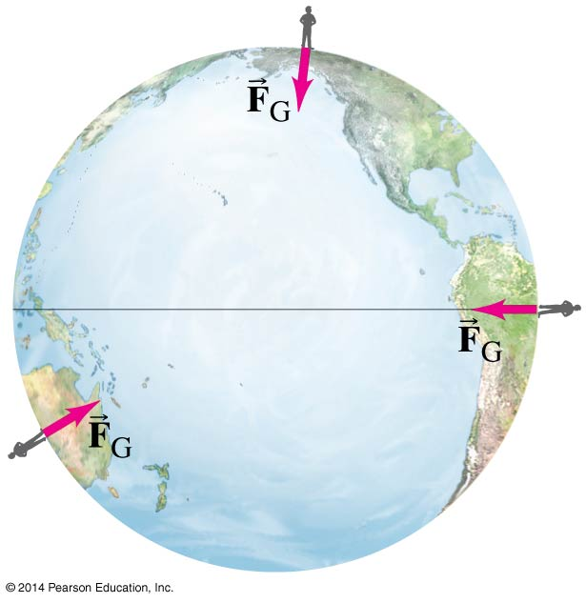
5-5 Newton’s Law of Universal Gravitation
If the force of gravity is being exerted on objects on Earth, what is the origin of that force?
Newton’s realization was that the force must come from the Earth.
He further realized that this force must be what keeps the Moon in its orbit.

Slide 24
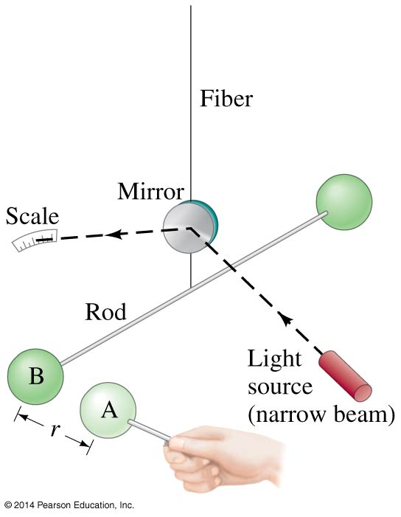
5-5 Newton’s Law of Universal Gravitation
The magnitude of the gravitational constant G can be measured in the laboratory.
This is the Cavendish experiment.

Slide 25
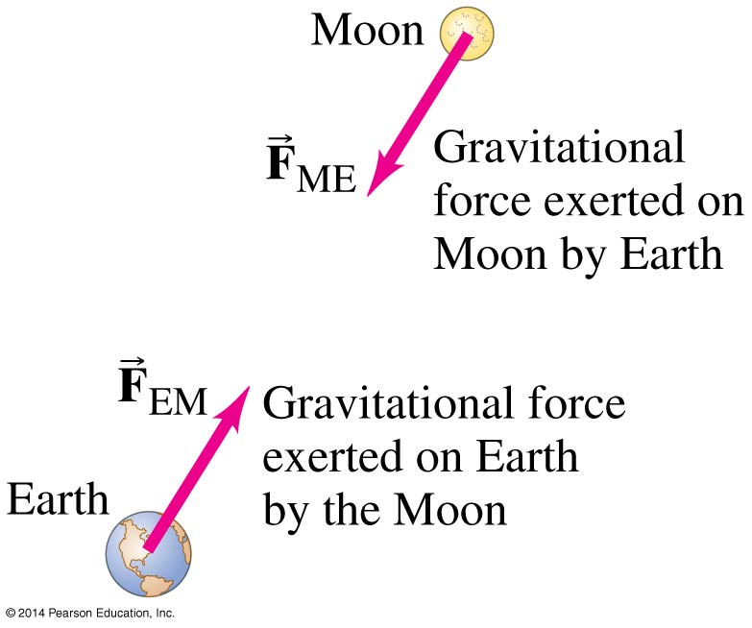
5-5 Newton’s Law of Universal Gravitation
The gravitational force on you is one-half of a Third Law pair: the Earth exerts a downward force on you, and you exert an upward force on the Earth.
When there is such a disparity in masses, the reaction force is undetectable, but for bodies more equal in mass it can be significant.

Slide 26
5-5 Newton’s Law of Universal Gravitation
Therefore, the gravitational force must be proportional to both masses.
By observing planetary orbits, Newton also concluded that the gravitational force must decrease as the inverse of the square of the distance between the masses.
In its final form, the Law of Universal Gravitation reads:
where G = 6.67 × 10⁻¹¹ N·m²/kg²
(5-4)

Slide 27
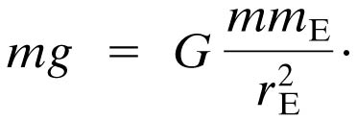
5-6 Gravity Near the Earth’s Surface Take out a piece of NB paper to hand in.
Calculate g (3 sig.figs.) if the mass of a person is 160 lbs.
and the mass of the earth is 5.98 x 10²⁴ kg
and its radius is 6370 km.
Remember
F = mg
therefore

Slide 28
5-6 Gravity Near the Earth’s Surface
The problem becomes:
g = G $\frac{m}{r^{2}}$ =
6.67 x 10⁻¹¹ N m²/kg² $\frac{5.98 x {10}^{24}}{{(6.37 x 10}^{6)2}}$
Do the numbers math and 10s separately
0.983 x 10¹ = g = 9.83 m/s²

Slide 29
5-6 Gravity Near the Earth’s Surface
Now we can relate the gravitational constant to the local acceleration of gravity. We know that, on the surface of the Earth:
Solving for g gives:
Now, knowing g and the radius of the Earth, the mass of the Earth can be calculated:

Slide 30
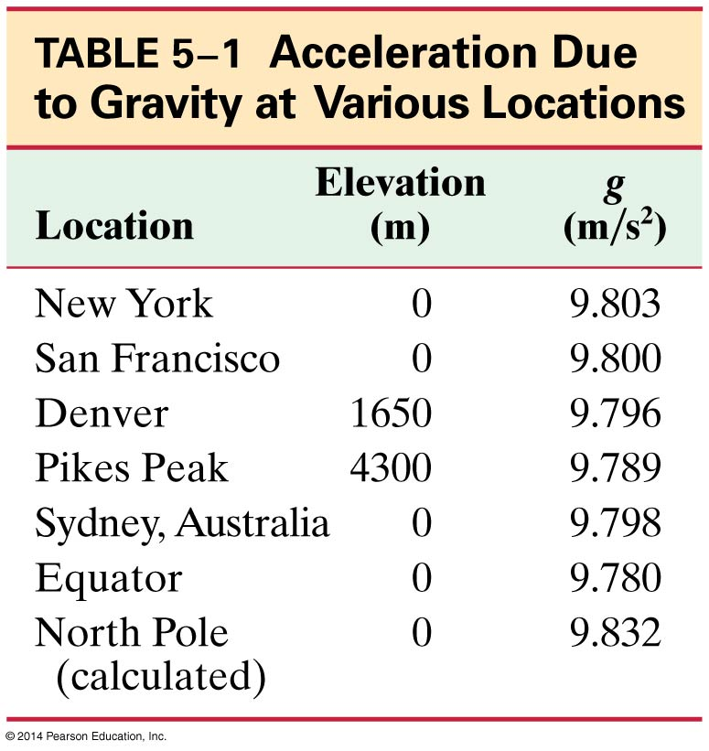
5-6 Gravity Near the Earth’s Surface
The acceleration due to gravity varies over the Earth’s surface due to altitude, local geology, and the shape of the Earth, which is not quite spherical. Difference between poles and equator distance is 43 km or 27 miles.

Slide 31
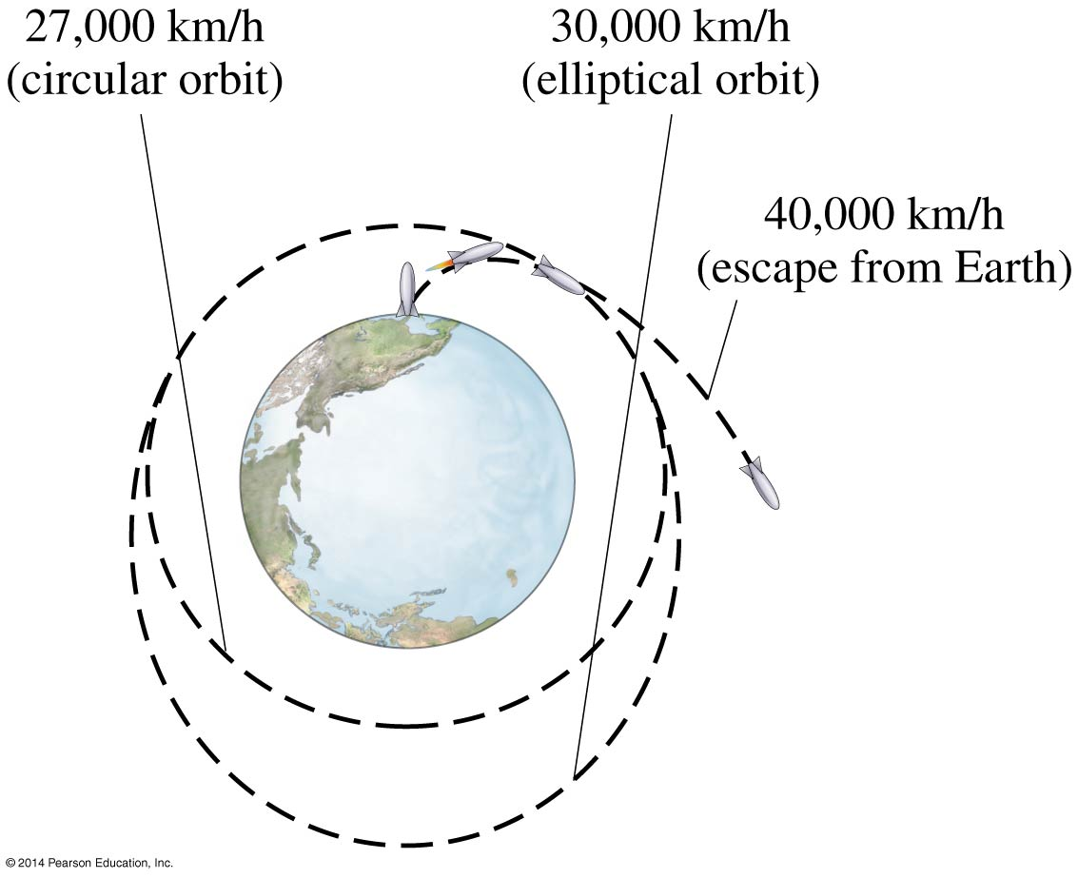
5-7 Satellites and “Weightlessness”
Satellites are routinely put into orbit around the Earth. The tangential speed must be high enough so that the satellite does not return to Earth, but not so high that it escapes Earth’s gravity altogether.

Slide 32
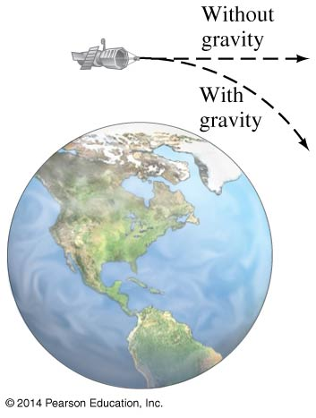
5-7 Satellites and “Weightlessness”
The satellite is kept in orbit by its speed—it is continually falling, but the Earth curves from underneath it.

Slide 33
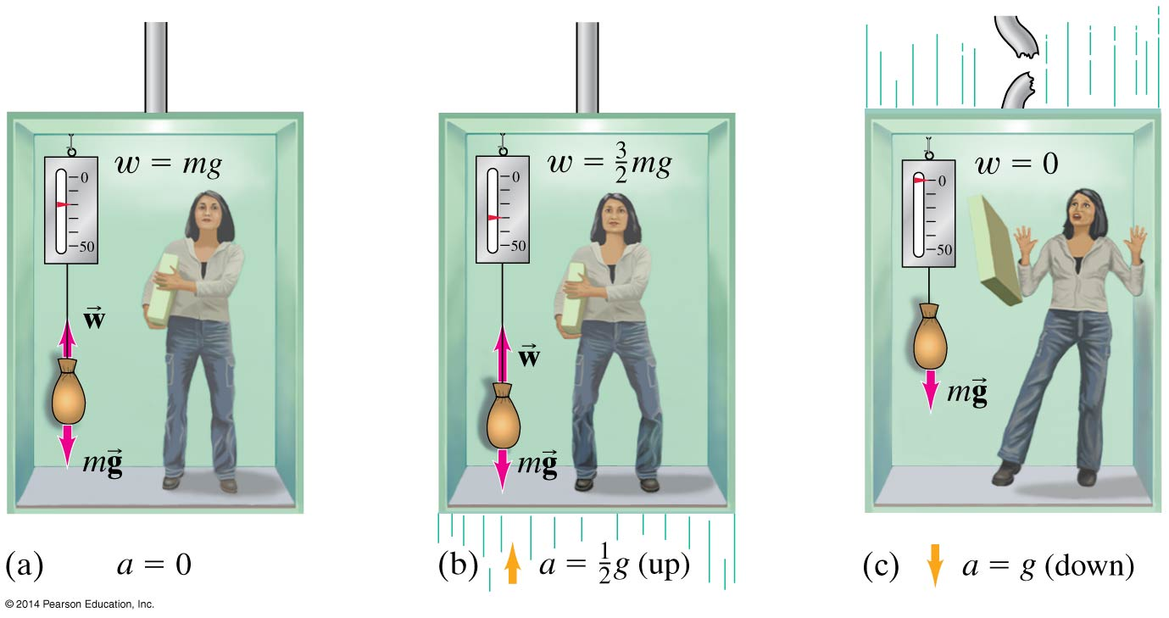
5-7 Satellites and “Weightlessness”
Objects in orbit are said to experience weightlessness. They do have a gravitational force acting on them, though!
The satellite and all its contents are in free fall, so there is no normal force. This is what leads to the experience of weightlessness.

Slide 34
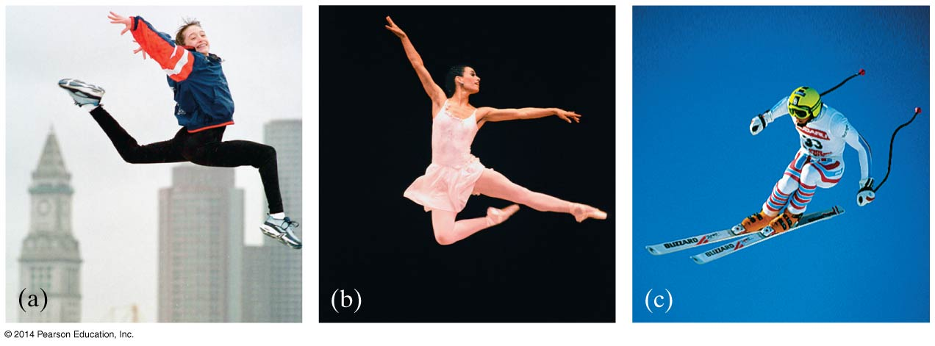
5-7 Satellites and “Weightlessness”
More properly, this effect is called apparent weightlessness, because the gravitational force still exists. It can be experienced on Earth as well, but only briefly:

Slide 35
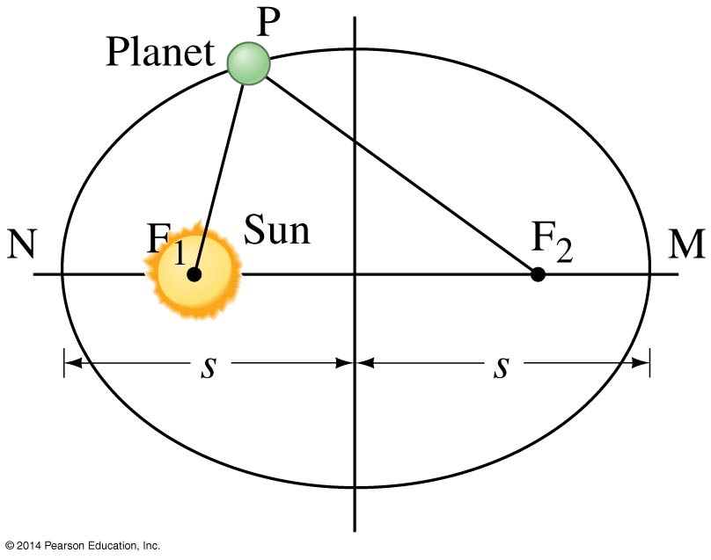
5-8 Planets, Kepler’s Laws, the Moon, and Newton’s Synthesis
Kepler’s laws describe planetary motion.
The orbit of each planet is an ellipse, with the Sun at one focus.

Slide 36
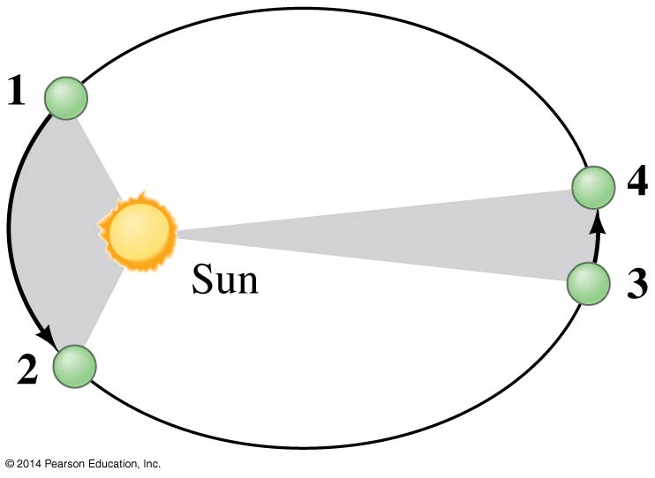
5-8 Planets, Kepler’s Laws, the Moon, and Newton’s Synthesis
An imaginary line drawn from each planet to the Sun sweeps out equal areas in equal times.

Slide 37
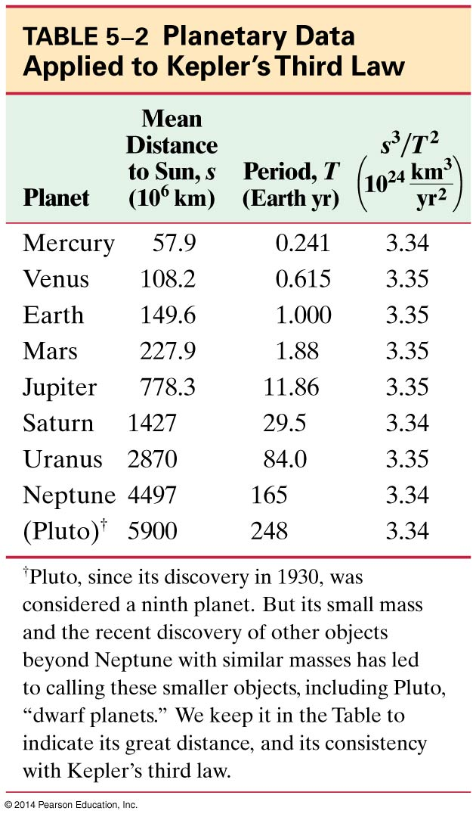
5-8 Planets, Kepler’s Laws, the Moon, and Newton’s Synthesis
3. The ratio of the square of a planet’s orbital period is proportional to the cube of its mean distance from the Sun.

Slide 38
5-8 Planets, Kepler’s Laws, the Moon, and Newton’s Synthesis
Kepler’s laws can be derived from Newton’s laws. Irregularities in planetary motion led to the discovery of Neptune, and irregularities in stellar motion have led to the discovery of many planets outside our Solar System.

Slide 39
5-9 Types of Forces in Nature
So, what about friction, the normal force, tension, and so on?
Except for gravity, the forces we experience every day are due to electromagnetic forces acting at the atomic level.

Slide 40
5-9 Types of Forces in Nature
Modern physics now recognizes four fundamental forces. Using the internet write in your notes answers to the following:
1) Names and sizes (strength & range) of the 4 forces
2) Explain where these forces operate
3) Who, how, when these forces were discovered
4) What would happen if these forces were changed

Slide 41
5-9 Types of Forces in Nature
Modern physics now recognizes four fundamental forces:
Gravity
Electromagnetism
Weak nuclear force (responsible for some types of radioactive decay)
Strong nuclear force (binds protons and neutrons together in the nucleus)

Slide 42
Summary of Chapter 5
Newton’s law of universal gravitation:
Satellites are able to stay in Earth orbit because of their large tangential speed.
(5-4)

Slide 43
Summary of Chapter 5
An object moving in a circle at constant speed is in uniform circular motion.
It has a centripetal acceleration
There is a centripetal force, which is the mass multiplied by the centripetal acceleration.
The centripetal force may be provided by friction, gravity, tension, the normal force, or others.
(5-1)

