Slide 1
Chapter 5: Newton's Third Law of Motion
© 2015 Pearson Education, Inc.

Slide 2
This lecture will help you understand:
Forces and Interactions
Newton's Third Law of Motion
Vectors and the Third Law
Summary of Newton's Three Laws of Motion

Slide 3
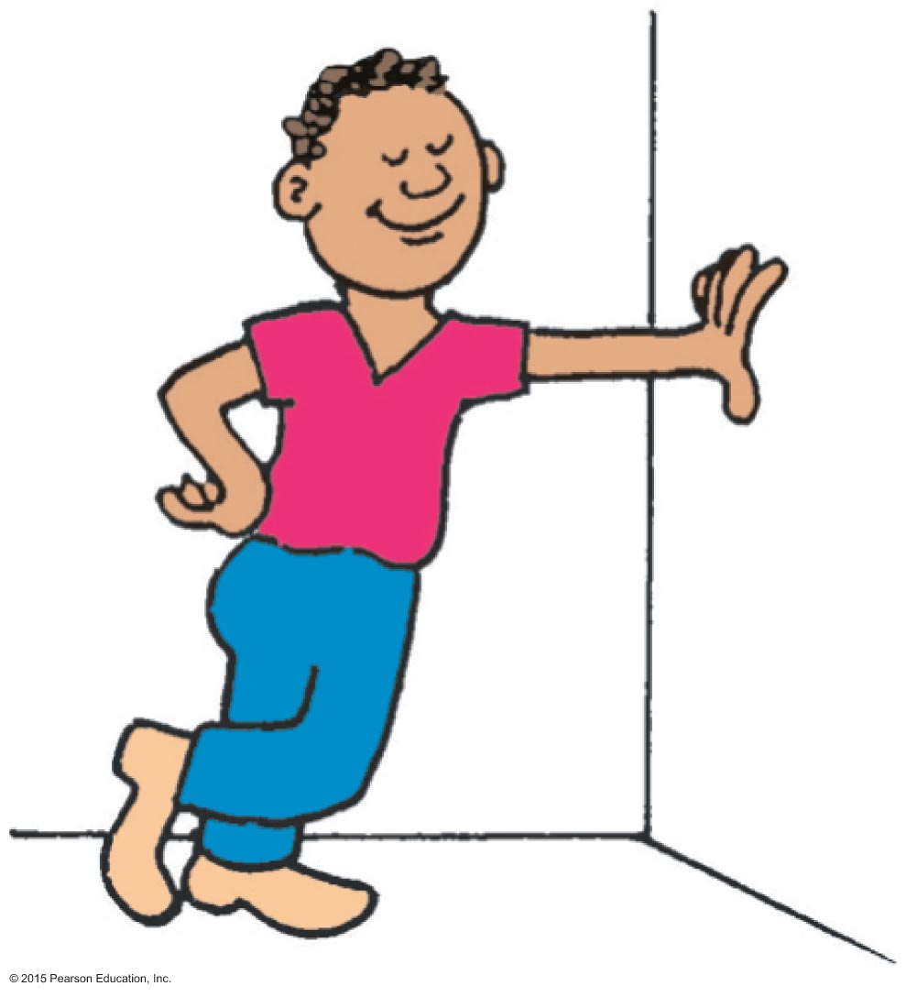
Forces and Interactions
Interaction
is between one thing and another.
requires a pair of forces acting on two objects.
Example: interaction of hand and wall pushing on each other Force pair—you push on wall; wall pushes on you.

Slide 4
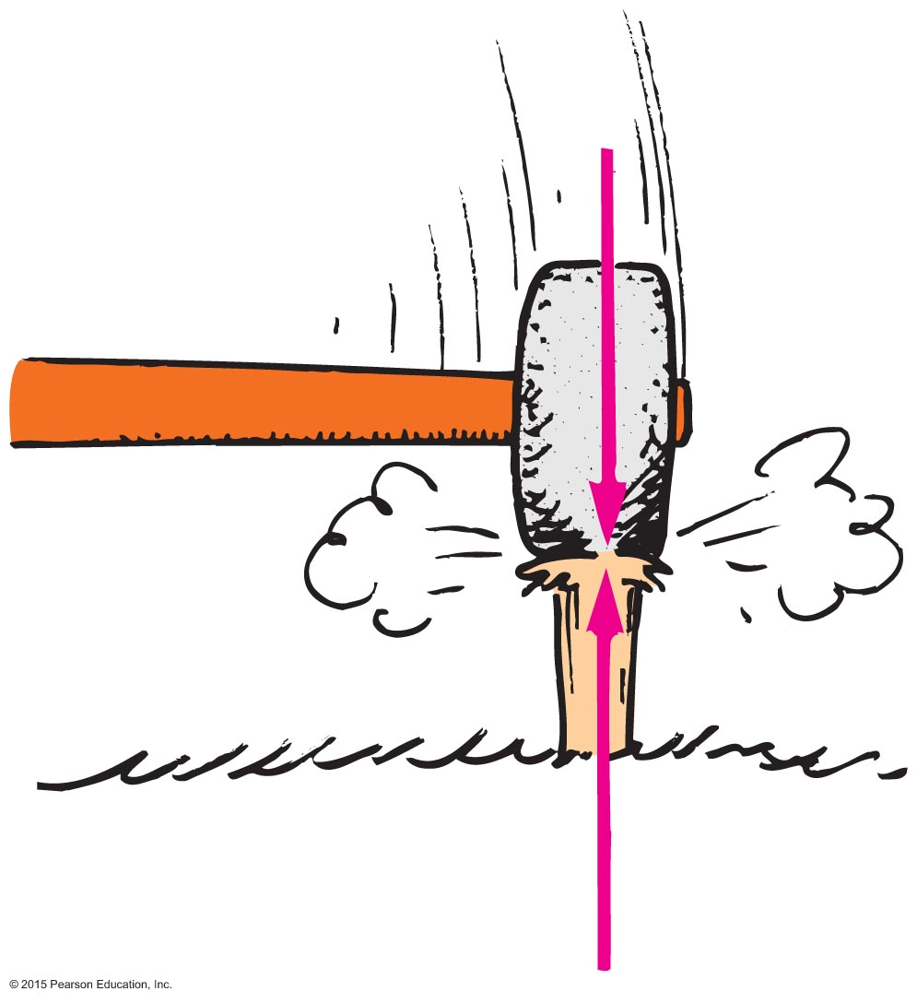
Newton's Third Law of Motion
Whenever one object exerts a force on a second object, the second object exerts an equal and opposite force on the first.

Slide 5
Newton's Third Law of Motion CHECK YOUR NEIGHBOR
A soccer player kicks a ball with 1500 N of force. The ball exerts a reaction force against the player's foot of
somewhat less than 1500 N.
1500 N.
somewhat more than 1500 N.
None of the above.
Notes:
B. 1500 N.

Slide 6
Newton's Third Law of Motion CHECK YOUR ANSWER
A soccer player kicks a ball with 1500 N of force. The ball exerts a reaction force against the player's foot of
1500 N.
Notes:
B. 1500 N.

Slide 7
Newton's Third Law of Motion, Continued
Action and reaction forces
one force is called the action force; the other force is called the reaction force.
are co-pairs of a single interaction.
neither force exists without the other.
are equal in strength and opposite in direction.
always act on different objects.

Slide 8
Newton's Third Law of Motion, Continued-1
Re-expression of Newton's third law:
To every action there is always an opposed equal reaction.
Example: Tires of car push back against the road while the road pushes the tires forward.

Slide 9
Newton's Third Law of Motion, Continued-2
Simple rule to identify action and reaction1A 2A 4A 1B 2B
Identify the interaction—one thing interacts with another
Action: Object A exerts a force on object B.
Reaction: Object B exerts a force on object A.
Example: Action—rocket (object A) exerts force on gas (object B). Reaction—gas (object B) exerts force on rocket (object A).

Slide 10
Newton's Third Law of Motion Space Shuttle Problem
The Space Shuttle at lift-off is 2 million kg with a thrust of 30.5 million N. Find the acceleration of the shuttle when it leaves the pad. (You may use 10 m/s²) Don’t forget you must over come the weight of the shuttle. F_{thrust} – weight = Net F
Notes:
C. you pulling Earth upward.

Slide 11
Newton's Third Law of Motion Space Shuttle Problem
G: m = 2mil kg Thrust = F = 30.5 mil N g = 10m/s²
F: a = ?? E: F = ma a = F/m
S&S: F_{net} = F_{thrust} – Wt = 30.5 mil N – (2 mil kg)(10)
F_{net} = 10.5 mil N
a = F/m = 10.5 mil N / 2 mil kg = 5.25 m/s²
A: a = 5.25 m/s²
This acceleration is 0.54 gees
Notes:
C. you pulling Earth upward.

Slide 12
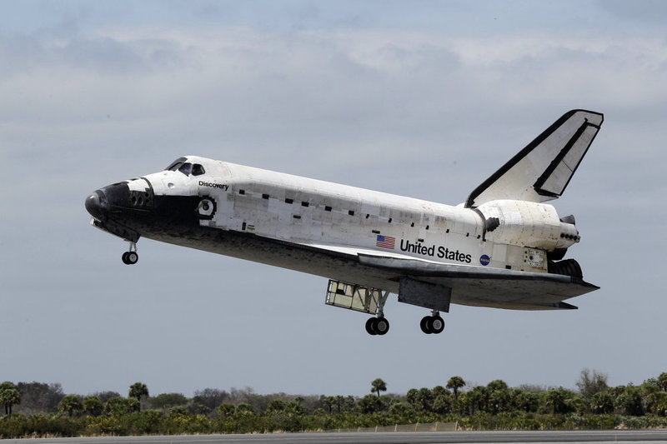
Newton's Third Law of Motion Space Shuttle Pictures
Notes:
C. you pulling Earth upward.

Slide 13
Newton's Third Law of Motion Space Shuttle Program Facts
Program started 1981 and ended 2011 (30 years)
Shuttle names - Columbia, Challenger, Discovery, Atlantis and Endeavour
Cost – Each shuttle cost about $2 billion to produce.
Total cost of the program $196 billion over 30 years
Fuel – Main engines (3) liquid hydrogen and oxygen.
Solid booster rockets (2).
Parts making up a shuttle – shuttle, 1 large liquid hydrogen/oxygen tank, 2 solid fuel rockets
Astronauts – 843 have flown missions
Failures (40%)– Challenger exploded during lift-off 1986 and
Columbia broke apart during re-entry 2003
Notes:
C. you pulling Earth upward.

Slide 14
Newton's Third Law of Motion2A CHECK YOUR NEIGHBOR, Continued
When you step off a curb, Earth pulls you downward. The reaction to this force is
a slight air resistance.
nonexistent in this case.
you pulling Earth upward.
None of the above.
Notes:
C. you pulling Earth upward.

Slide 15
Newton's Third Law of Motion CHECK YOUR ANSWER, Continued
When you step off a curb, Earth pulls you downward. The reaction to this force is
you pulling Earth upward.
Comment:
Due to the enormous mass of Earth, don't look for evidence of the upward pull on Earth!
Notes:
C. you pulling Earth upward.

Slide 16
Newton's Third Law of Motion CHECK YOUR NEIGHBOR, Continued-1
When you step off a curb, Earth pulls you downward and you pull Earth upward. Why do you not sense Earth moving upward toward you?
Earth is fixed, so it cannot move.
Earth can move, but other objects on it prevent it from moving.
It moves, but by an imperceptible amount.
None of the above.
Notes:
C. It moves, but by an imperceptible amount.

Slide 17
Newton's Third Law of Motion1A 4A CHECK YOUR ANSWER, Continued-1
When you step off a curb, Earth pulls you downward and you pull Earth upward. Why do you not sense Earth moving upward toward you?
It moves, but by an imperceptible amount.
Explanation:
The force you exert on Earth is just as much as the force Earth exerts on you. You move more than Earth does because Earth's mass is enormously greater than your mass. Earth's tiny motion is less than you can perceive. (Can you accept what you can't see?)
Notes:
C. It moves, but by an imperceptible amount.

Slide 18
Newton's Third Law of Motion, Continued-3
Action and Reaction on Different Masses
Cannonball:
Cannon:
The same force exerted on a small mass produces a large acceleration.
The same force exerted on a large mass produces a small acceleration.

Slide 19
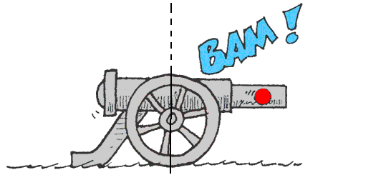
Newton's Third Law of Motion1B 2B CHECK YOUR NEIGHBOR, Continued-2
When a cannon is fired, the accelerations of the cannon and cannonball are different because the
forces don't occur at the same time.
forces, although theoretically the same, in practice are not.
masses are different.
ratios of force to mass are the same.
Notes:
C. masses are different.

Slide 20
Newton's Third Law of Motion CHECK YOUR ANSWER, Continued-2
When a cannon is fired, the accelerations of the cannon and cannonball are different because the
masses are different.
Notes:
C. masses are different.

Slide 21
Newton's Third Law of Motion CHECK YOUR NEIGHBOR, Continued-3
Consider a high-speed bus colliding head-on with a flying bug. The force of impact splatters the unfortunate bug over the windshield. Which is greater, the force on the bug or the force on the bus?
Bug
Bus
Both the same amount.
Cannot say
Notes:
C. Both the same amount.

Slide 22
Newton's Third Law of Motion CHECK YOUR ANSWER, Continued-3
Consider a high-speed bus colliding head-on with a flying bug. The force of impact splatters the unfortunate bug over the windshield. Which is greater, the force on the bug or the force on the bus?
Both the same amount.
Comment:
Although the forces are equal in magnitude, the effects are very different. Do you know why?
Notes:
C. Both the same amount.

Slide 23
Newton's Third Law of Motion CHECK YOUR NEIGHBOR, Continued-4
Two people of equal mass on slippery ice push off from each other. Will both move at the same speed in opposite directions?
Yes
Yes, but only if both push equally.
No
No, unless acceleration occurs.
Notes:
A. Yes

Slide 24
Newton's Third Law of Motion CHECK YOUR ANSWER, Continued-4
Two people of equal mass on slippery ice push off from each other. Will both move at the same speed in opposite directions?
Yes
Explanation:
In whatever way they push, equal-magnitude forces acting on equal masses produce equal accelerations; therefore, both undergo equal changes in speed.
Notes:
A. Yes

Slide 25
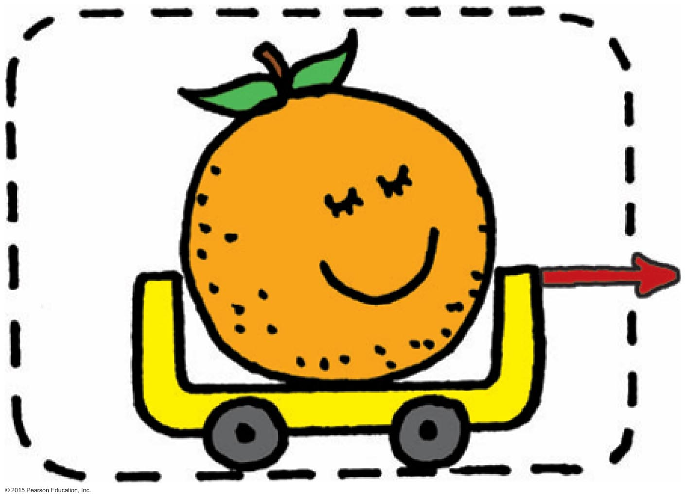
Newton's Third Law of Motion, Continued-4
Defining Your System
Consider a single enclosed orange.
Applied external force causes the orange to accelerate in accord with Newton's second law.
We see here only the action force (red vector).

Slide 26
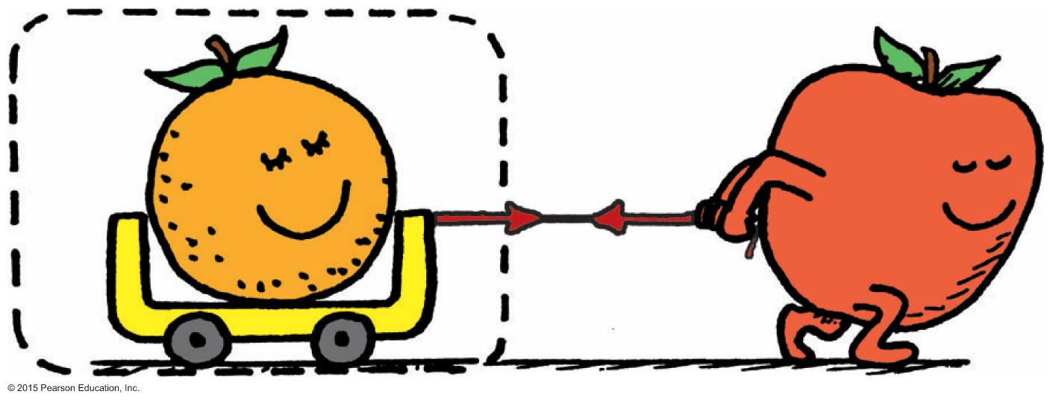
Newton's Third Law of Motion, Continued-5
Consider the orange and the apple pulling on it.
Action and reaction do not cancel (because they act on different objects).
External force by apple accelerates the orange.

Slide 27
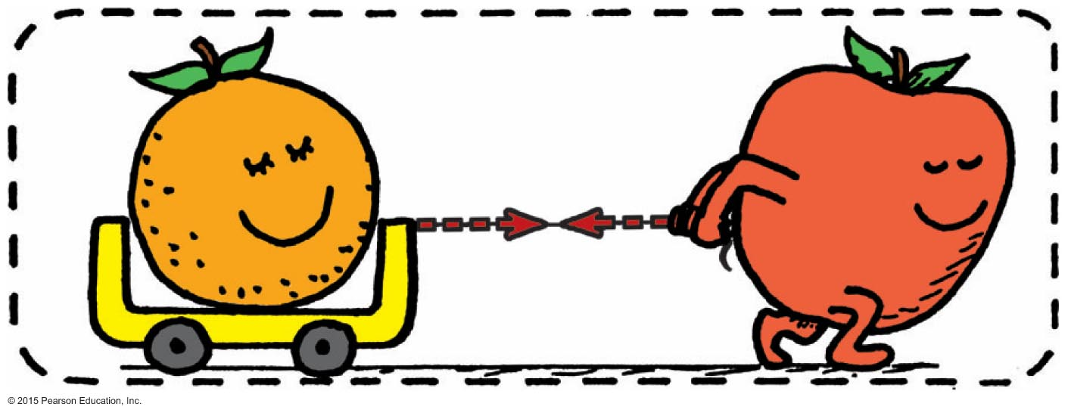
Newton's Third Law of Motion, Continued-6
Consider a system comprising both the orange and the apple.
The apple is no longer external to the system.
Force pair is internal to the system, which doesn't cause acceleration.
Action and reaction within the system cancel.
With no external forces, there is no acceleration of the system.

Slide 28
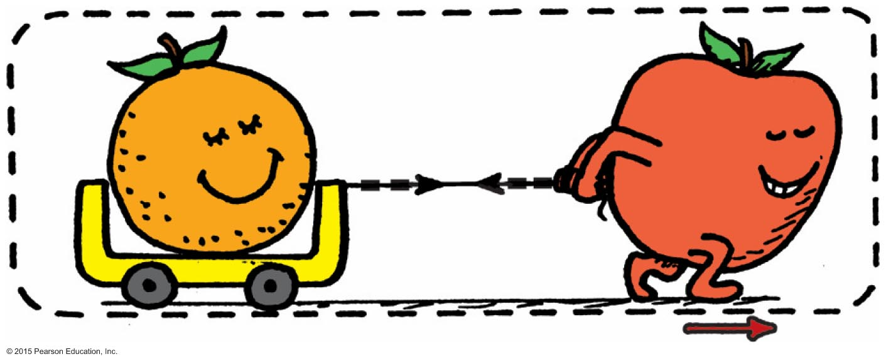
Newton's Third Law of Motion, Continued-7
Aha! Here's the same system, but with external force of friction on it (friction between the apple's feet and the floor).
External frictional force of the floor accelerates the system.

Slide 29
Newton's Third Law of Motion CHECK YOUR NEIGHBOR, Continued-5
The apple-orange system will move with constant speed if
the orange loses mass.
the apple gains mass.
a force equal and opposite to the friction force occurs.
None of the above.
Notes:
C. a force equal and opposite to the friction force occurs.

Slide 30
Newton's Third Law of Motion CHECK YOUR ANSWER, Continued-5
The apple-orange system will move with constant speed if
a force equal and opposite to the friction force occurs.
Comment:
Such a force may be floor friction on the cart wheels, or even a force produced by an opposing wind.
Notes:
C. a force equal and opposite to the friction force occurs.

Slide 31
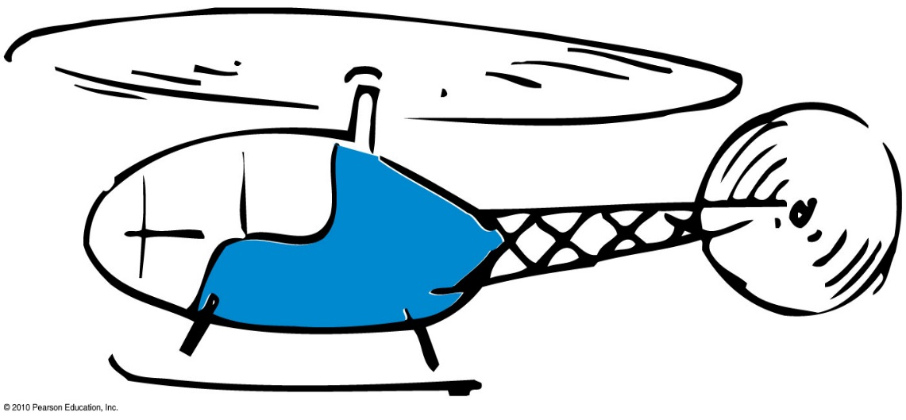
Newton's Third Law of Motion CHECK YOUR NEIGHBOR, Continued-6
Consider the flight of a helicopter. When lift is greater than the helicopter's weight, the helicopter
moves downward.
moves upward.
hovers in midair.
None of the above.
Notes:
B. moves upward.

Slide 32
Newton's Third Law of Motion CHECK YOUR ANSWER, Continued-6
Consider the flight of a helicopter. When lift is greater than the helicopter's weight, the helicopter
moves upward.
Notes:
B. moves upward.

Slide 33
Newton's Third Law of Motion CHECK YOUR NEIGHBOR, Continued-7
A bird flies by
flapping its wings.
pushing air down so that the air pushes it upward.
hovering in midair.
inhaling and exhaling air.
Notes:
B. pushing air down so that the air pushes it upward.

Slide 34
Newton's Third Law of Motion CHECK YOUR ANSWER, Continued-7
A bird flies by
pushing air down so that the air pushes it upward.
Notes:
B. pushing air down so that the air pushes it upward.

Slide 35
Newton's Third Law of Motion CHECK YOUR NEIGHBOR, Continued-8
Slightly tilted wings of airplanes deflect
oncoming air downward to produce lift.
oncoming air upward to produce lift.
Both A and B.
Neither A nor B.
Notes:
A. oncoming air downward to produce lift.

Slide 36
Newton's Third Law of Motion CHECK YOUR ANSWER, Continued-8
Slightly tilted wings of airplanes deflect
oncoming air downward to produce lift.
Explanation:
When a wing diverts air downward, it exerts a downward force on the air. The air simultaneously exerts an upward force on the wing. The vertical component of this upward force is lift. (The horizontal component is drag.)
Notes:
A. oncoming air downward to produce lift.

Slide 37
Newton's Third Law of Motion CHECK YOUR NEIGHBOR, Continued-9
Compared with a lightweight glider, a heavier glider would have to push air
downward with greater force.
downward with the same force.
downward with less force.
None of the above.
Notes:
A. downward with greater force.

Slide 38
Newton's Third Law of Motion CHECK YOUR ANSWER, Continued-9
Compared with a lightweight glider, a heavier glider would have to push air
downward with greater force.
Explanation:
The force on the air deflected downward must equal the weight of the glider.
Notes:
A. downward with greater force.

Slide 39
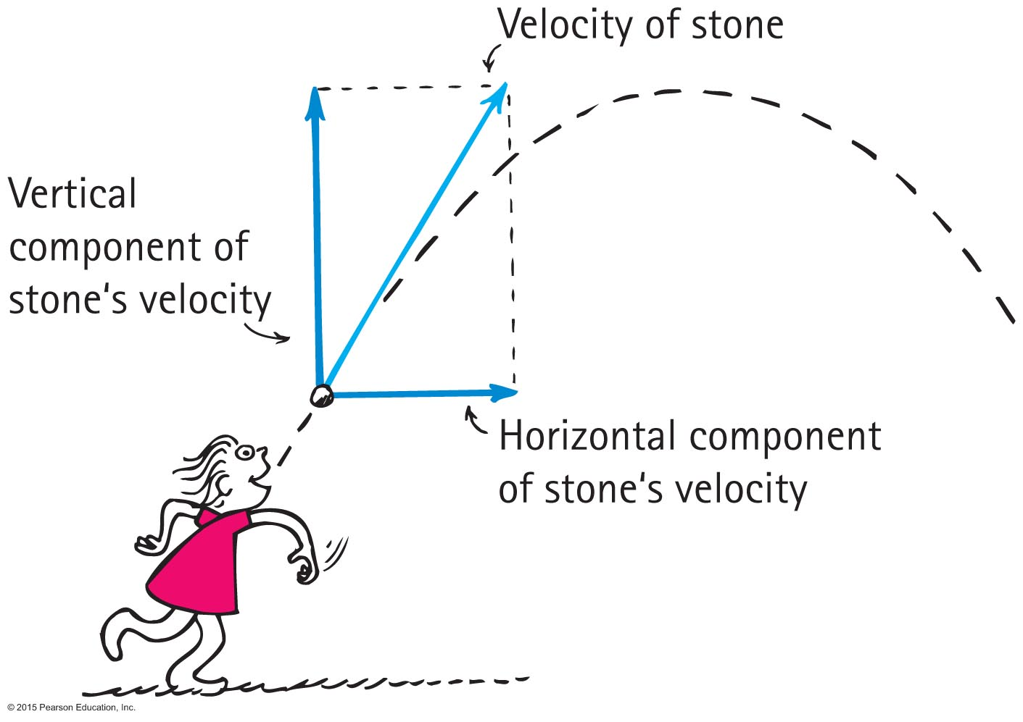
Vectors4A
Vector components
Vertical and horizontal components of a vector are perpendicular to each other.
Determined by resolution.

Slide 40
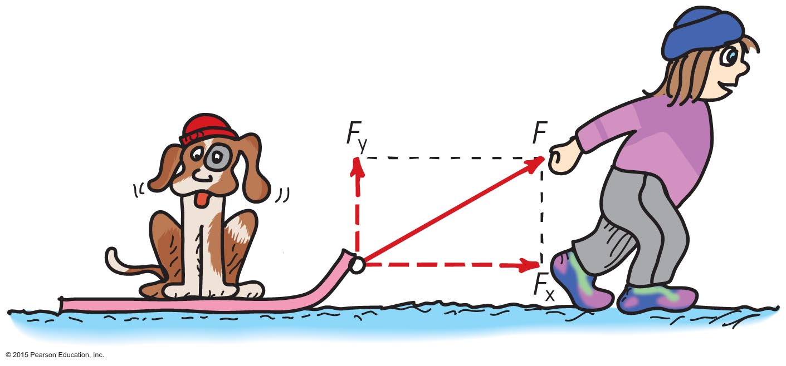
Vectors, Continued
Nellie Newton pulls on the sled as shown.
Which component of her force F is greater?
What two other forces (not shown) act on the sled?

Slide 41
Vectors, Continued-1
Nellie Newton pulls on the sled as shown.
Which component of her force F is greater?
The horizontal component
is greater.
What two other forces (not shown) act on the sled?
Weight mg and normal N also act on the sled.

Slide 42
Vectors, Continued-1
Nellie Newton pulls on the sled with 20 N at an angle of 30º with the horizontal, find the acceleration of the dog/sled if its mass is 10 kg.

Slide 43
Vectors, Continued-1
G: F = 20 N θ = 30º m = 10 kg
F: a = ?? E: F = ma SOHCAHTA
S&S: F =

Slide 44
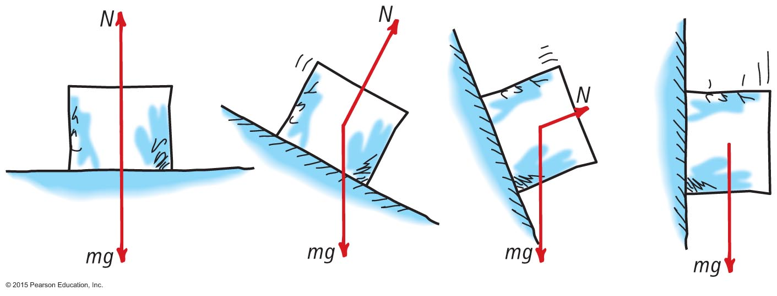
Vectors, Continued-21A
Two forces act on the block of ice.
As the ramp is raised, which force remains constant?
As the ramp is raised, how does the magnitude of N change?
When the ramp is raised 90 degrees (vertical) what is the net force on the block?

Slide 45
Vectors, Continued-32A 1B
Two forces act on the block of ice.
As the ramp is raised, which force remains constant? mg
As the ramp is raised, how does the magnitude of N change? N decreases with increased angle of the ramp.
When the ramp is raised 90 degrees (vertical) what is the net force on the block? The net force is mg!

Slide 46
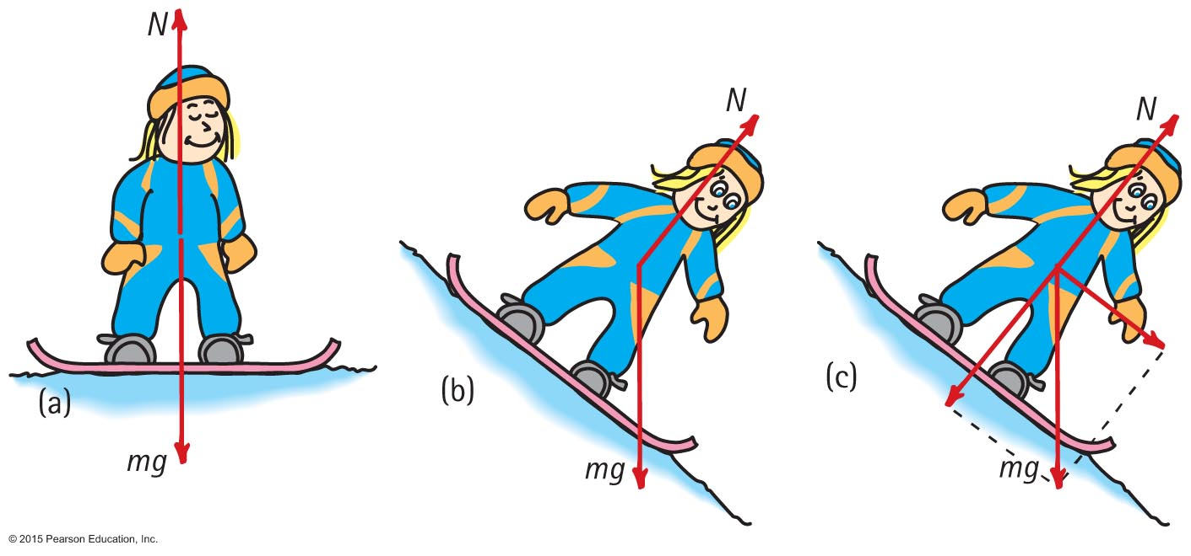
Vectors, Continued-4
Can you see that N and mg are equal and opposite?
Can you see that N is less on the incline?
Can you see that the resultant of N and mg is the force propelling Nellie down the hill? And can you see which component of mg is equal and opposite to N?

Slide 47
Summary of Newton's Three Laws of Motion2B
Newton's first law of motion (the law of inertia)
An object at rest tends to remain at rest; an object in motion tends to remain in motion at constant speed along a straight-line path.
Newton's second law of motion (the law of acceleration)
When a net force acts on an object, the object will accelerate. The acceleration is directly proportional to the net force and inversely proportional to the mass.
F = ma
Newton's third law of motion (the law of Rockets action and reaction)
Whenever one object exerts a force on a second object, the second object exerts an equal and opposite force on the first.

Slide 48
Physics Trigonometry Functions
a² + b² = c² Pythagorean Theorem
Sine, Cosine, and Tangent Functions
SOH CAH TOA
(1, 2, $\sqrt{3}$) (1, 1, $\sqrt{2}$) (3, 4, 5)
(5, 12, 13) (8, 15, 17) and their multiples
These are called Pythagorean Triples.

