Slide 1
Chapter 3: Linear Motion
© 2015 Pearson Education, Inc.

Slide 2
This lecture will help you understand:
Motion Is Relative
Speed
Velocity
Acceleration
Free Fall
Velocity Vectors

Slide 3

Motion Is Relative
Motion of objects is always described as relative to something else. For example:
  You walk on the road
  relative to Earth, but
  Earth is moving relative
  to the Sun.
  So your motion relative
  to the Sun is different from
  your motion relative to Earth.

Slide 4

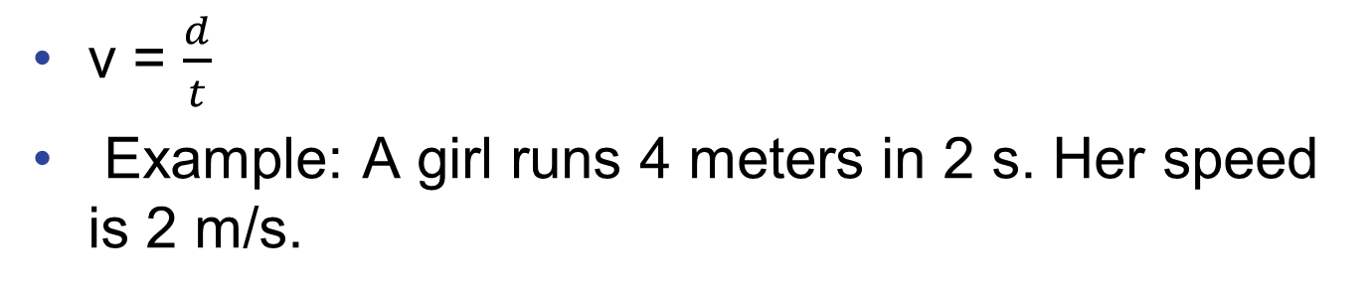
Speed
Defined as the distance covered per amount of travel time.
Units are meters per second or ft / s
In equation form:
v = $\frac{d}{t}$
Example: A girl runs 4 meters in 2 s. Her speed is 2 m/s.

Slide 5

Average Speed
The total distance covered divided by the total travel time.
  Doesn't indicate various instantaneous speeds along the way.
In equation form:
Example: Drive a distance of 200 km in 2 h and your average speed is 100 km/h.

Slide 6
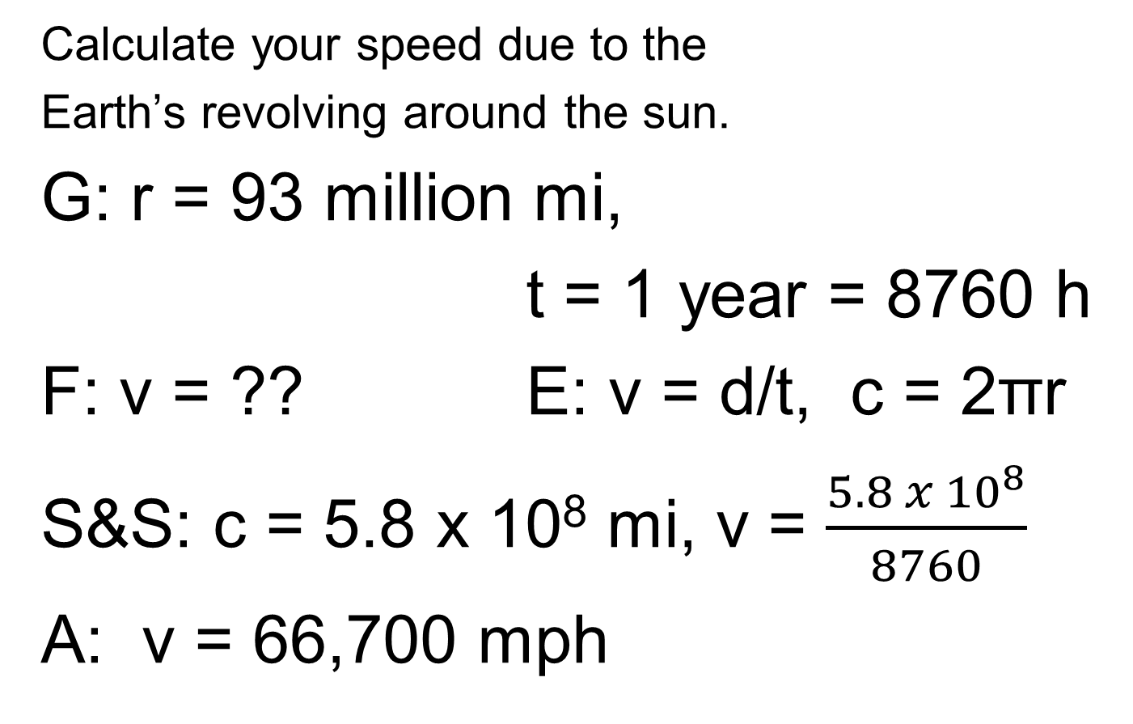
Motion Is Relative2B 1A 2A 4A
Calculate your speed due to the
Earth’s revolving around the sun.
G: r = 93 million mi,
t = 1 year = 8760 h
F: v = ?? E: v = d/t, c = 2πr
S&S: c = 5.8 x 10⁸ mi, v = $\frac{5.8 x 10^{8}}{8760}$
A: v = 66,700 mph

Slide 7
Average Speed
CHECK YOUR NEIGHBOR
The average speed of driving 30 km in 1 hour is the same as the average speed of driving
30 km in 1/2 hour.
30 km in 2 hours.
60 km in 1/2 hour.
60 km in 2 hours.
Notes:
7
D. 60 km in 2 hours.

Slide 8

Average Speed
CHECK YOUR ANSWER
The average speed of driving 30 km in 1 hour is the same as the average speed of driving
60 km in 2 hours.
Explanation:
Average speed = total distance / time
So, average speed = 30 km / 1 h = 30 km/h.
Now, if we drive 60 km in 2 hours:
Average speed = 60 km / 2 h = 30 km/h
Same
Notes:
8
D. 60 km in 2 hours.

Slide 9
Instantaneous Speed1BHCP
Instantaneous speed is the speed at any instant.
Example:
  When you ride in your car, you may speed up and slow down with speed at any instant that is normally quite different than your average speed.
  Your instantaneous speed is given by your speedometer.

Slide 10
Velocity
A description of both
  the instantaneous speed of the object.
  the direction of travel.
Velocity is a vector quantity. It has
  Magnitude (speed) and Direction.
  Velocity is "directed" speed.

Slide 11
Speed and Velocity
Constant speed is steady speed, neither speeding up nor slowing down.
Constant velocity is
  constant speed and
  constant direction (straight-line path with no acceleration).
Motion is relative to the surface of the Earth, unless otherwise stated.

Slide 12
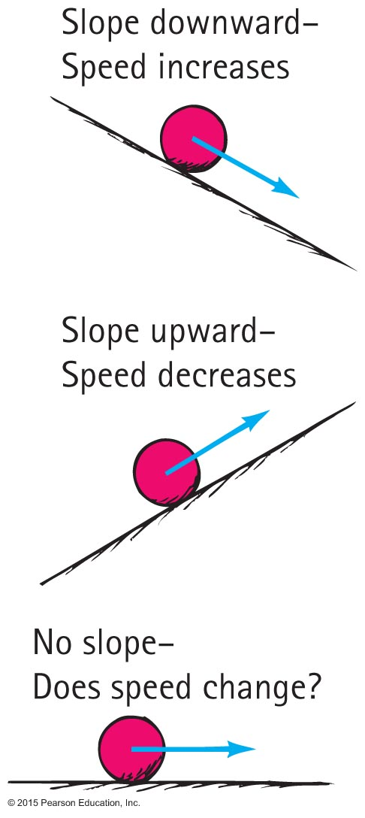
Acceleration
Formulated by Galileo based on his experiments with inclined planes.
Rate at which velocity changes over time.

Slide 13

Acceleration, Continued2A
Acceleration involves a
  change in speed, or
  change in direction, or
  both.
Example: Car making a turn.
What happens to your full glass of soda when you go around a corner?

Slide 14

Acceleration, Continued-11A 4A
In equation form:
Units of acceleration is units of velocity / unit of time.
Example:
  Your car's speed may presently be 40 km/h.
  Your car's speed 5 s later is 50 km/h.
  Your car's change in speed is 50 - 40 = 10 km/h.
  Your car's acceleration is 10 km/h·5 s = 2 km/h·s.

Slide 15
Acceleration
CHECK YOUR NEIGHBOR
An automobile is accelerating when it is
slowing down to a stop.
rounding a curve at a steady speed.
Both of the above.
Neither of the above.
Notes:
15
C. Both of the above.

Slide 16
Acceleration
CHECK YOUR ANSWER
An automobile is accelerating when it is
Both of the above.
Explanation:
Change in speed (increase or decrease) per time is acceleration, so slowing is acceleration.
Change in direction is acceleration (even if speed stays the same), so rounding a curve is acceleration.
Notes:
16
Acceleration occurs due to a change in either speed or direction (or both).
When a car slows down it changes its speed, so it is accelerating.
When a car rounds a curve, although its speed is steady it is accelerating because it is changing direction.

Slide 17
Acceleration
CHECK YOUR NEIGHBOR, Continued
Acceleration and velocity are actually
the same.
rates but for different quantities.
the same when direction is not a factor.
the same when an object is freely falling.
Notes:
17
B. rates but for different quantities.

Slide 18
Acceleration
CHECK YOUR ANSWER, Continued
Acceleration and velocity are actually
rates but for different quantities.
Explanation:
Velocity is the rate at which distance traveled changes over time,
Acceleration is the rate at which velocity changes over time.
Notes:
18
B. rates but for different quantities.

Slide 19
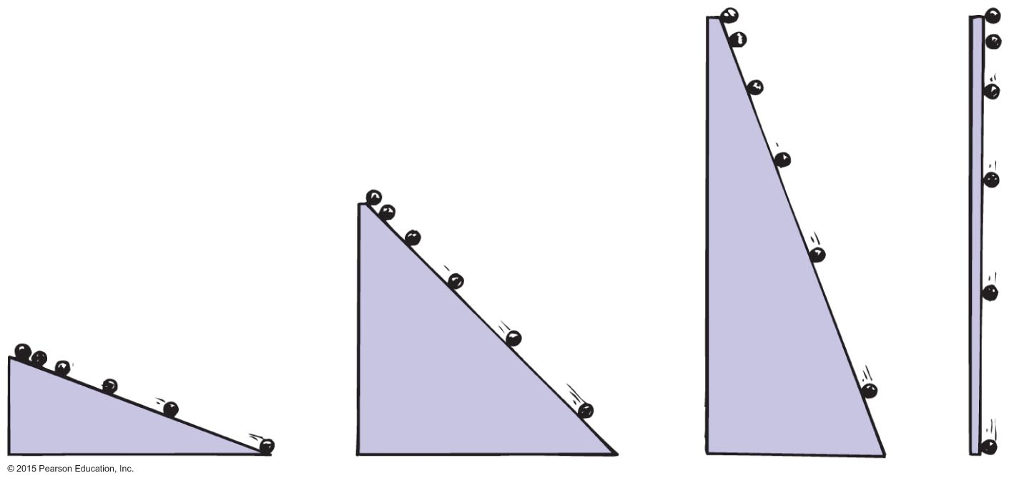
Acceleration, Continued-2
Galileo increased the inclination of inclined planes.
  Steeper inclines result in greater accelerations.
  When the incline is vertical, acceleration is at maximum, the same as that of a falling object.
  When air resistance is negligible, all objects fall with the same unchanging acceleration.

Slide 20
Free Fall
Falling under the influence of gravity only-with no air resistance is called FREE FALL
Freely falling objects on Earth accelerate at the rate of about 10 m/s·s, that is, 10 m/s² or more precisely 9.8 m/s² and the number we will use from now on.

Slide 21
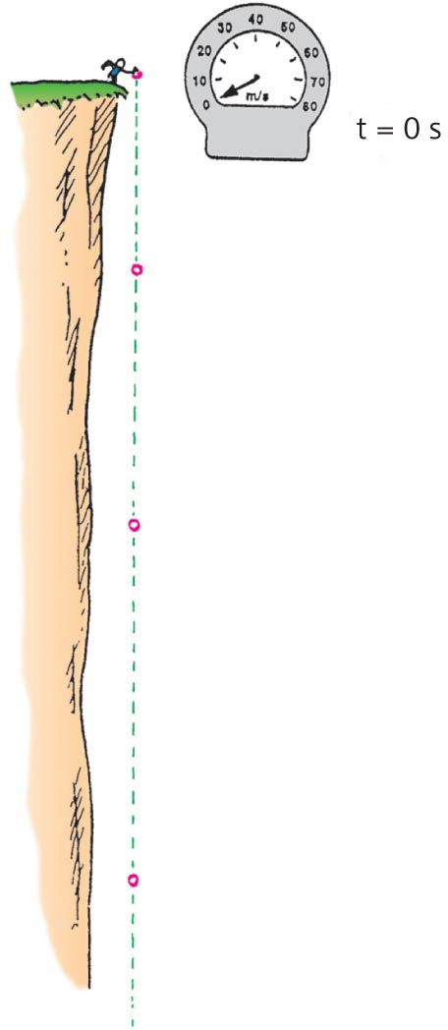

Free Fall—How Fast?1A 1B 2B
The velocity acquired by an object
starting from rest is
So, under free fall, when
acceleration is 9.8 m/s²
, the speed is
  9.8 m/s after 1 s.
  19.6 m/s after 2 s.
  29.4 m/s after 3 s.
  And so on.

Slide 22
Free Fall—How Fast?
CHECK YOUR NEIGHBOR
At a particular instant a free-falling object has a speed of 30 m/s. Exactly 1 s later its speed will be
the same.
35 m/s.
more than 35 m/s.
60 m/s.
Notes:
22
C. more than 35 m/s

Slide 23
Free Fall—How Fast?
CHECK YOUR ANSWER
At a particular instant a free-falling object has a speed of 30 m/s. Exactly 1 s later its speed will be
more than 35 m/s.
Explanation:
One second later its speed will be 40 m/s, which is more than 35 m/s.
Notes:
23
The object gains 10 m/s after every second.
So, at a given instance, if its speed is 30 m/s, then a second later it will be 10 m/s greater than that, that is, 30 m/s + 10 m/s = 40 m/s
So, its speed a second later is 40 m/s which is more than 35 m/s.

Slide 24
Free Fall—How Far?
The distance covered by an accelerating object starting from rest is
x (or d) = ½ a t²
Under free fall, when acceleration is 9.8 m/s², the distance from the start is:
  4.9 m after 1 s.
  19.6 m after 2 s.
  44.1 m after 3 s.
  And so on.

Slide 25
Free Fall—How Far?
CHECK YOUR NEIGHBOR
What is the approximate distance fallen after 4 s for a freely falling object starting from rest?
4 m
16 m
40 m
80 m
Notes:
25
D. 80 m

Slide 26
Free Fall—How Far?
CHECK YOUR ANSWER
What is the distance fallen after 4 s for a freely falling object starting from rest?
80 m
Explanation:
So:
So:
Notes:
26
D. 80 m

Slide 27
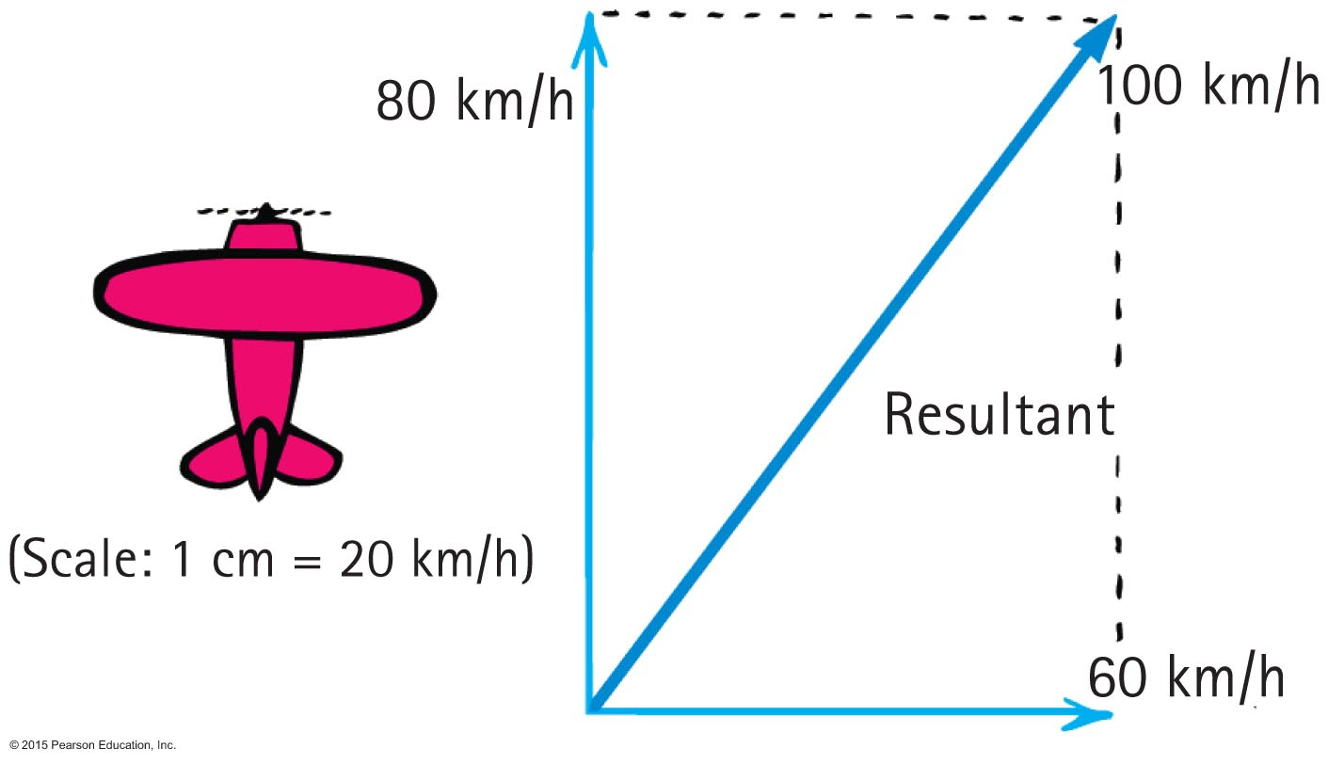
Vectors
CHECK YOUR NEIGHBOR
The 60-km/h crosswind blows the 80-km/h airplane off course at 100 km/h. If the crosswind were 80 km/h, the airplane would travel at 113 km/h at an angle of
less than 45 degrees.
45 degrees.
more than 45 degrees.
None of the above are correct.
Notes:
27
B. 45 degrees

Slide 28
Vectors
CHECK YOUR NEIGHBOR
The 60-km/h crosswind blows the 80-km/h airplane off course at 100 km/h. If the crosswind were 80 km/h, the airplane would travel at ?? km/h at an angle of
less than 45 degrees.
45 degrees.
more than 45 degrees.
None of the above are correct.
Notes:
28
B. 45 degrees

Slide 29
Vectors
CHECK YOUR ANSWER
The 60-km/h crosswind blows the 80-km/h airplane off course at 100 km/h. If the crosswind were 80 km/h, the airplane would travel at 113 km/h at an angle of
45 degrees.
Comment:
The parallelogram would then be a square with a 45-degree diagona
Notes:
29
B. 45 degrees

Slide 30
Vectors
CHECK YOUR NEIGHBOR, Continued
You run horizontally at 4 m/s in a vertically falling rain that falls at 4 m/s. Relative to you, the raindrops are falling at an angle of
0°.
45°.
53°.
90°.
Notes:
B. 45°.

Slide 31
Vectors
CHECK YOUR ANSWER, Continued
You run horizontally at 4 m/s in a vertically falling rain that falls at 4 m/s. Relative to you, the raindrops are falling at an angle of
45°.
Explanation:
The horizontal 4 m/s and vertical 4 m/s combine by the parallelogram rule to produce a resultant of 5.6 m/s at 45°. Again, the parallelogram is a square.
Notes:
B. 45°.

